Slide 1
GROUP – 1
CN5000 – DATABASE SYSTEMS

Slide 2
MEMBERS
HARD
JAYRUP
SHYAM
YOGI

Slide 3
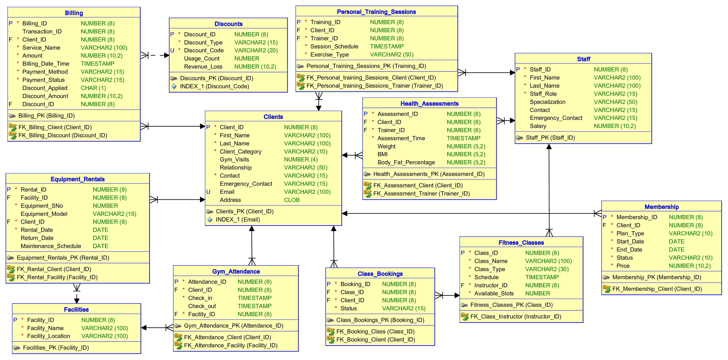
ERD

Slide 4
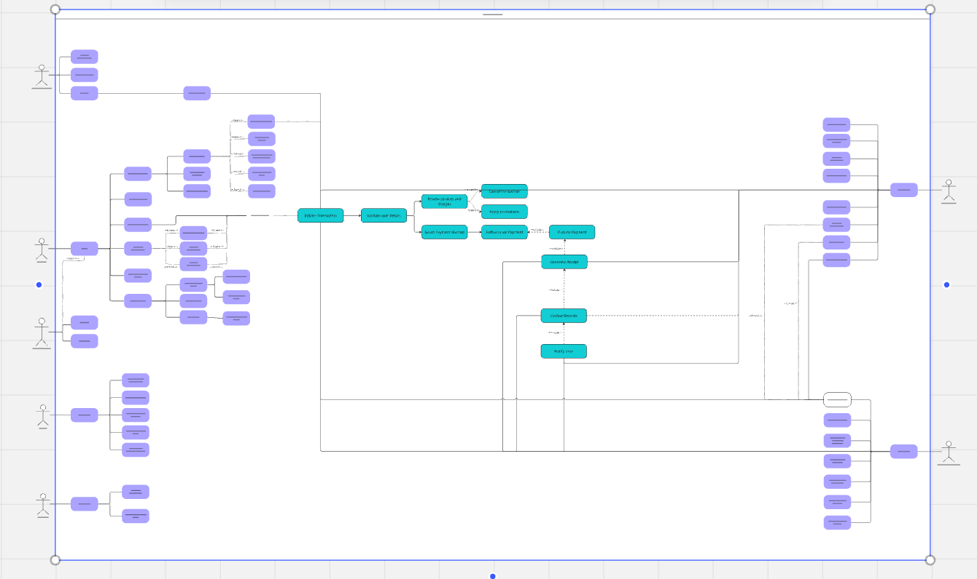
USE-CASE

Slide 5
Gantt Chart

Slide 6
THANK YOU!
QUESTIONS?

